Slide 1
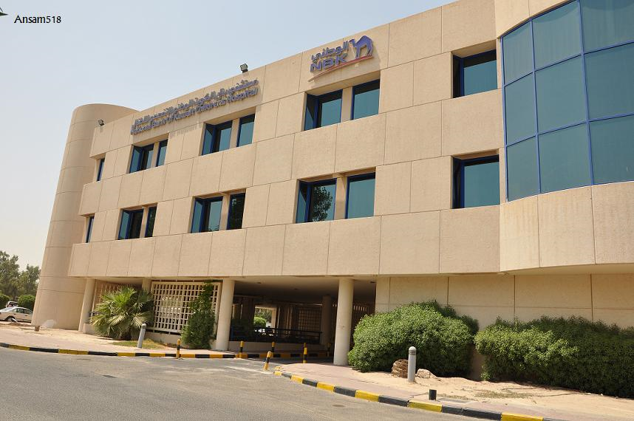
Glance of Clinical Experience in NBK Children Hospital
Asma Al-Turkait
MSc Clinical Pharmacy (UCL-2014)
B.Pharm(KU-2009)

Slide 2
A View
Al-Sabah Paediatric
Pharmacy
NBK
Specialized
Haem./Onc.
NBK 1&2(Haem)
NBK 3(ONC)
General
Paediatrics
Five wards
PICU

Slide 3
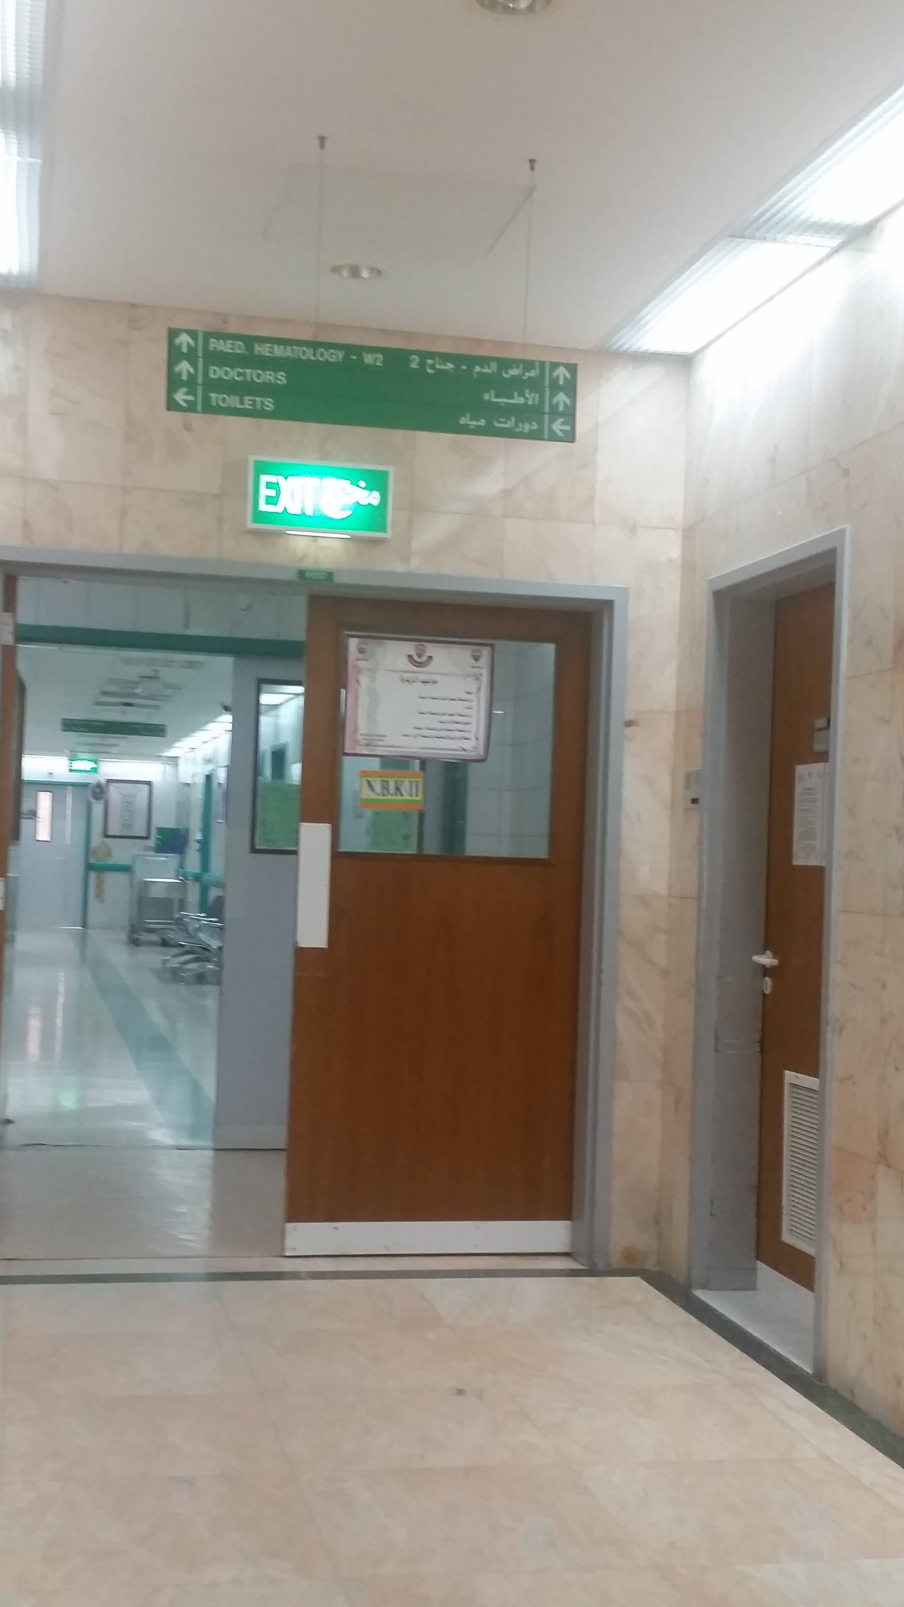
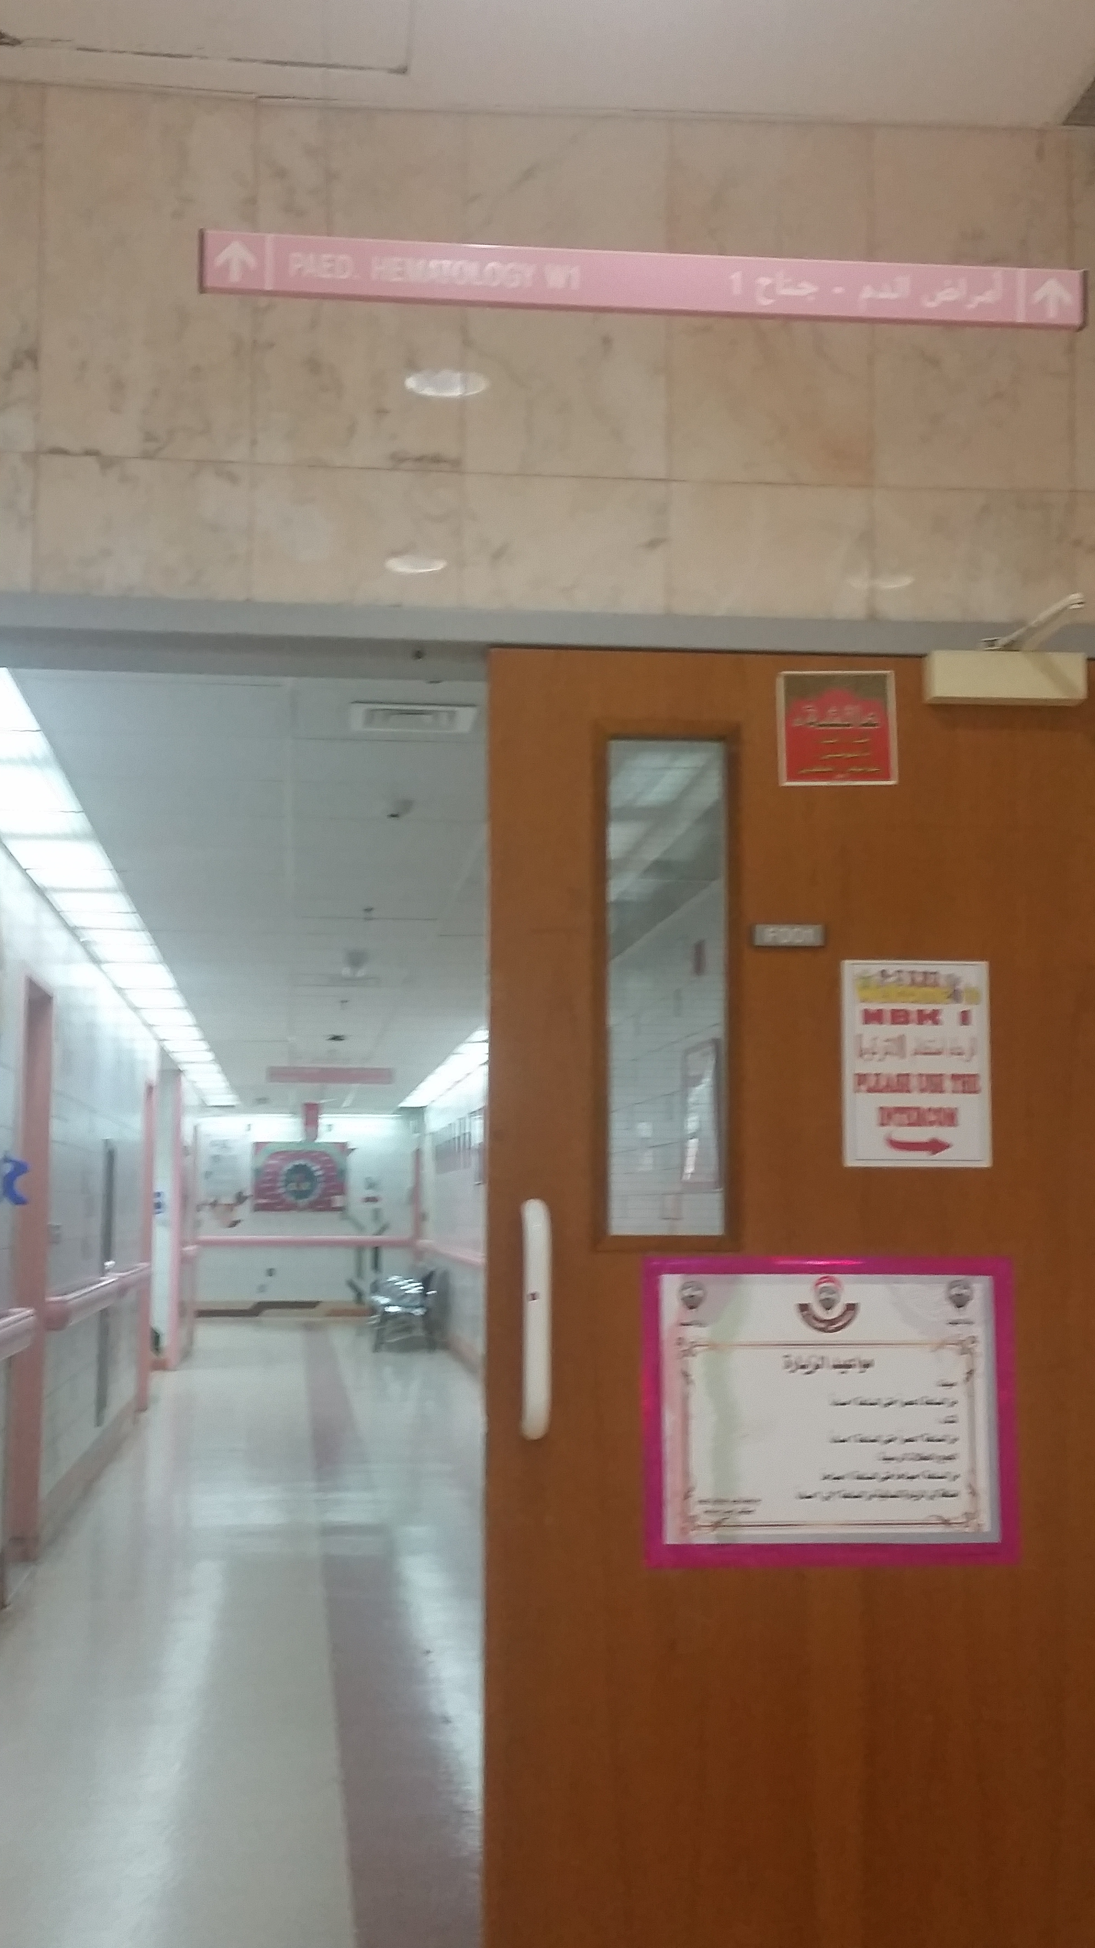
Clinical Services
Paediatric (general) with 1 unit+ pharmacy services(Time Challenge!)
Full time clinical pharmacist at NBK children cancer Department (since October 2015)
Clinical services(NBK1 and 2)
Morning MDT meetings (2days/week)
Major rounds(2days/week)
Responding to questions(Doctors, nurses, parents )
Educational lectures(Nurses, parents & children)
Intervention(s)where possible (Antimicrobials & chemo related SEs)

Slide 4
Critical Examples From Practice
Review medication(s) that elevates the liver enzymes for 11 years old boy(induction cycle of ALL+ chickenpox encephalitis)
Haematoma around Central line, can we shift to peripheral for the following chemo
etoposide,cytarabine,daunorubicin ??
Piperacillin
/Tazobactam SHORTAGE
Modification of febrile neutropenia protocol Suggestions?!
4 years old boy ALL with recurrent aspergillosis refractory to oral voriconazole?!

Slide 5
Achievement (Modification of the OPD chemotherapy order sheets to reduce the prescribing errors)
Replaced
With

Slide 6
New Chemotherapy Form

Slide 7
Challenges
A critical specialty ,requires quick response
Shortage of Staff
Minimum resources
A Need for a team ☺
Time to document the interventions, and where?!

Slide 8
Pharmacist intervention form

Slide 9
Thank You for your Attention

